Slide 1

Prediction of black Friday/ cyber monday Walmart sales
Team nexgen, project 1
DATA ANALYTICS BOOT CAMP
Tasneem bhaijee, Hannah golledge, yen tran, adil ahmed
Notes:
NexGen

Slide 2
MOTivation and Project summary
Core Message
Our project consists of analyzing Walmart sales trend during the course of years 2010 thru 2013. Therefore, we will be analyzing historical sales data and any special contributing factors towards the impact in sales.
Summary of Findings
Sales revenue during Black Friday/Cyber Monday was highest in 2010 as compared to 2011 and 2012
Average sales during week before Christmas (week 51) was the highest throughout the year
Notes:
Adil

Slide 3
Data questions THAT WERE CONSIDERED
Determine highest sales revenue based on the US holidays
Study the average sales per week for all stores and departments throughout the years 2010-2013.
Determine top 3 stores and bottom 3 stores per average sales
Determine 3 top departments per average sales
Determine weekly sales per holiday throughout the year
Does holiday have any impact in the # of sales revenue?
Contributing factors/correlation to sales revenue, such as:
Temperature, CPI, Unemployment, Fuel Price, Holiday
Notes:
Adil

Slide 4
Data cleanup and exploration
Review CSV files; read them
Determine data types definition
Cleanup Process
Explore data info in every csv file to ensure all data is complete; if incomplete, we dropped the data
Converted the date
Dropped empty fields (Markdowns); drop NA’s
Merged data using inner joins based on common columns (i.e., Store, Date, IsHoliday)
The date field was broken down by year, month and day
Notes:
Tasneem

Slide 5
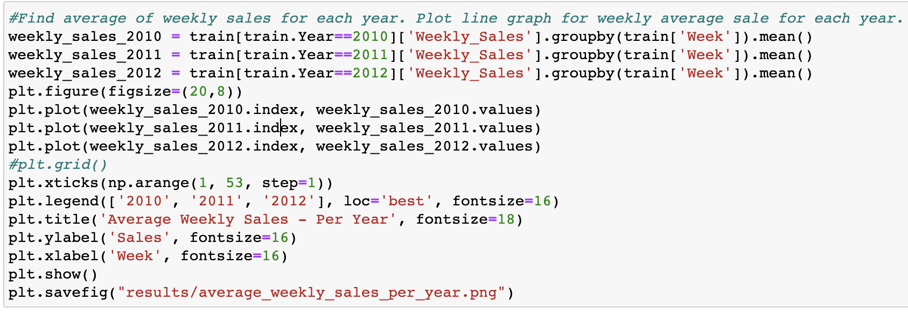
Data analysiS
Used Jupyter Notebook Code for Plotting Average Weekly Sales
Notes:
Tasneem

Slide 6
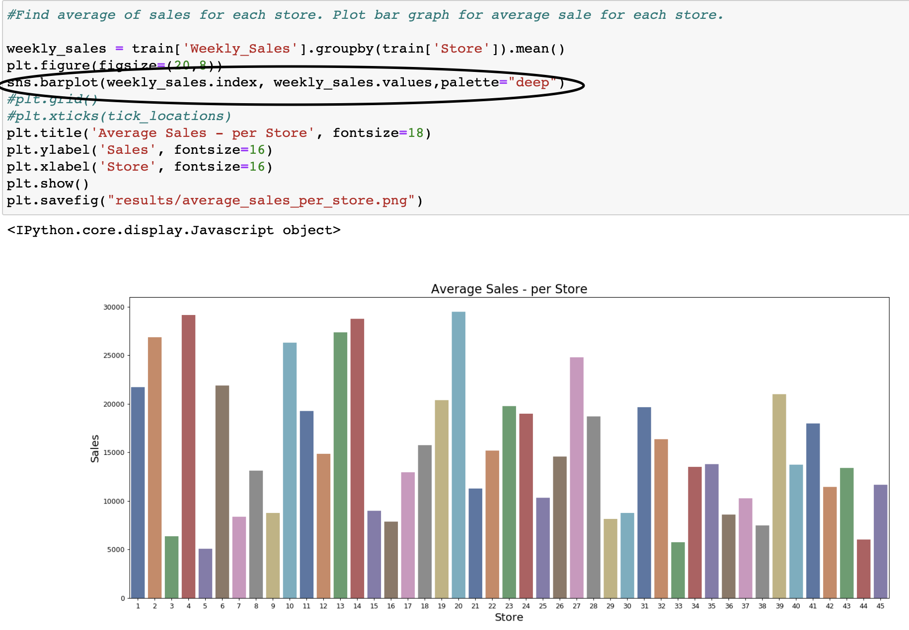
DATA ANALYSIS (CON’T)
To get the color palette for the bar charts, we imported the seaborn library:
import seaborn as sns
Notes:
Tasneem

Slide 7
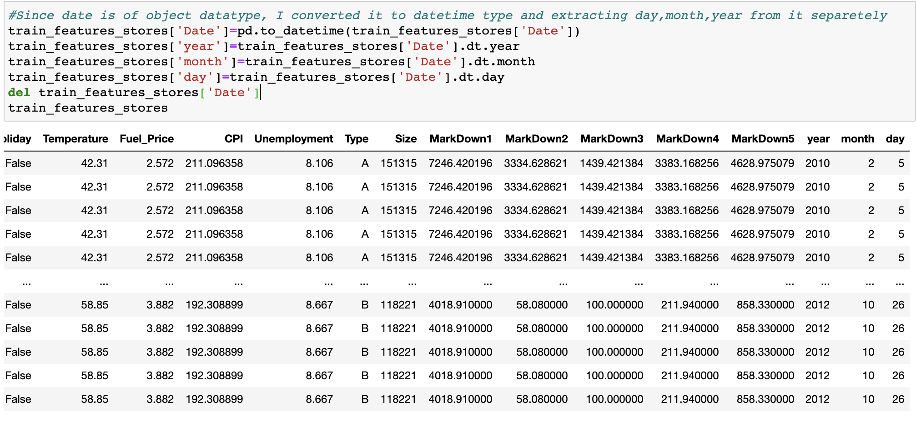
DATA ANALYSIS (CON’T)
This code was essential to convert date from object datatype to datetime type
Additionally, we were able to extract the day, month and year from it separately
Notes:
Tasneem

Slide 8
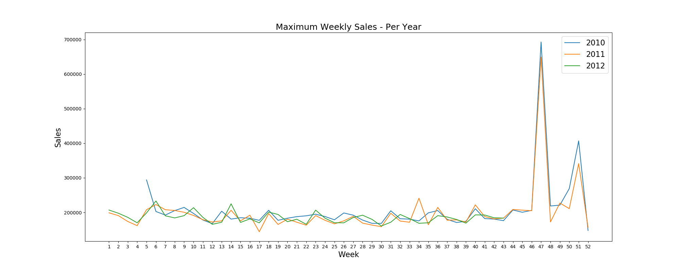
Results and findings
Sales Revenue
Sales revenue for Week 47 is the highest for all years. Black Friday/Cyber Monday occurs during Week 47. From the below graph, year 2010 sales were higher than 2011; Full 2012 data was not available.
Notes:
Hannah

Slide 9
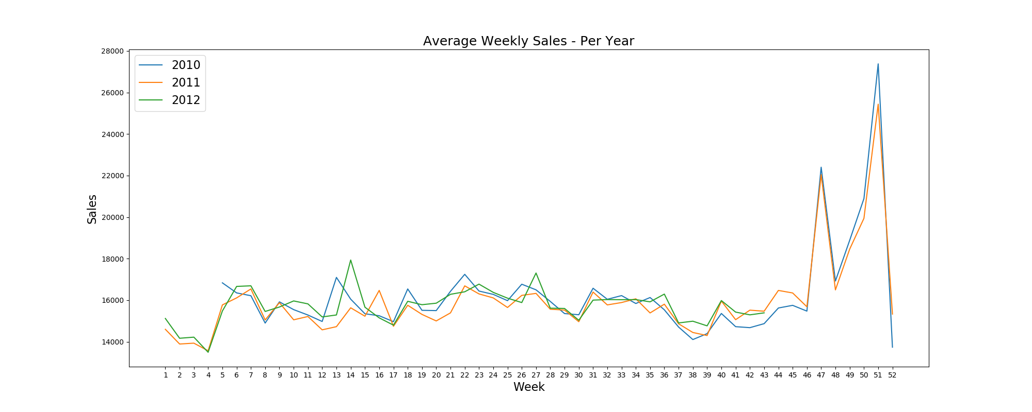
Results and findings (Con’T)
Sales Revenue
1st peak – Week before Christmas (Week 51)
Average weekly sales revenue for Week 51 is the highest for all years. Christmas occurs right after Week 51. From the below graph, year 2010 avg sales were higher than 2011; Full 2012 data was not available.
2nd peak – Thanksgiving Week: Black Friday/Cyber Monday (Week 47)
2010 had the most average weekly sales
Notes:
Hannah

Slide 10
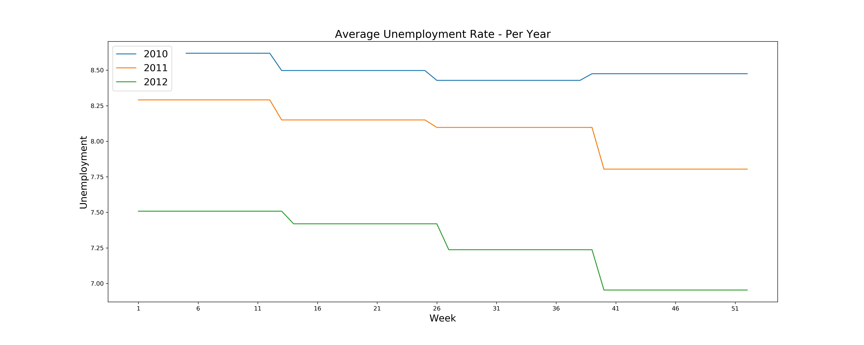
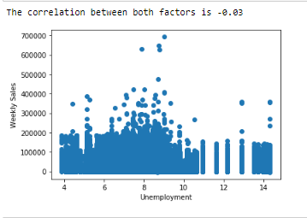
Results and findings (con’t)
Unemployment
2010
Highest unemployment rate of 8.5% during Week 41 thru 51.
2011
Unemployment rate of 7.8% during Week 41 thru 51.
2012
Unemployment rate of 3.5% during Week 41 thru 51.
Correlation
The R-Value between unemployment rate and weekly sales revenue was -0.03.
There was no specific correlation in unemployment to the Walmart sales revenue.
Walmart is known as a “discount store”. Therefore, higher unemployment rate results in higher sales for Walmart.
Notes:
Hannah
In the year 2010, the unemployment rate was 8.5% in the weeks 41 to 51. This was the highest unemployment rate out of the three years studied. From week 41 to 46, the average weekly sales were the lowest. The sales average spiked during the week of Black Friday (week 47). Week 50, the week before Christmas, had the greatest weekly sales of the year.
In the year 2011, the unemployment rate was 7.8% in the weeks 41 to 51. Like 2010, the weekly sales spiked during the week of Black Friday. The year 2010 showed a slightly greater weekly sales amount during that time. The week before Christmas had the greatest sales of the year, but it was slightly less than that of the previous year.
In the year 2012, during the weeks 41 to 51, the unemployment rate was 3.5%. Unfortunately, the data for the average weekly sales stops at week 43, so there is no information on the week of Black Friday.
When comparing the unemployment chart to the CPI chart, the lower the unemployment rate, the higher the CPI.
Unemployment rate and weekly sales revenue are inversely proportional.

Slide 11
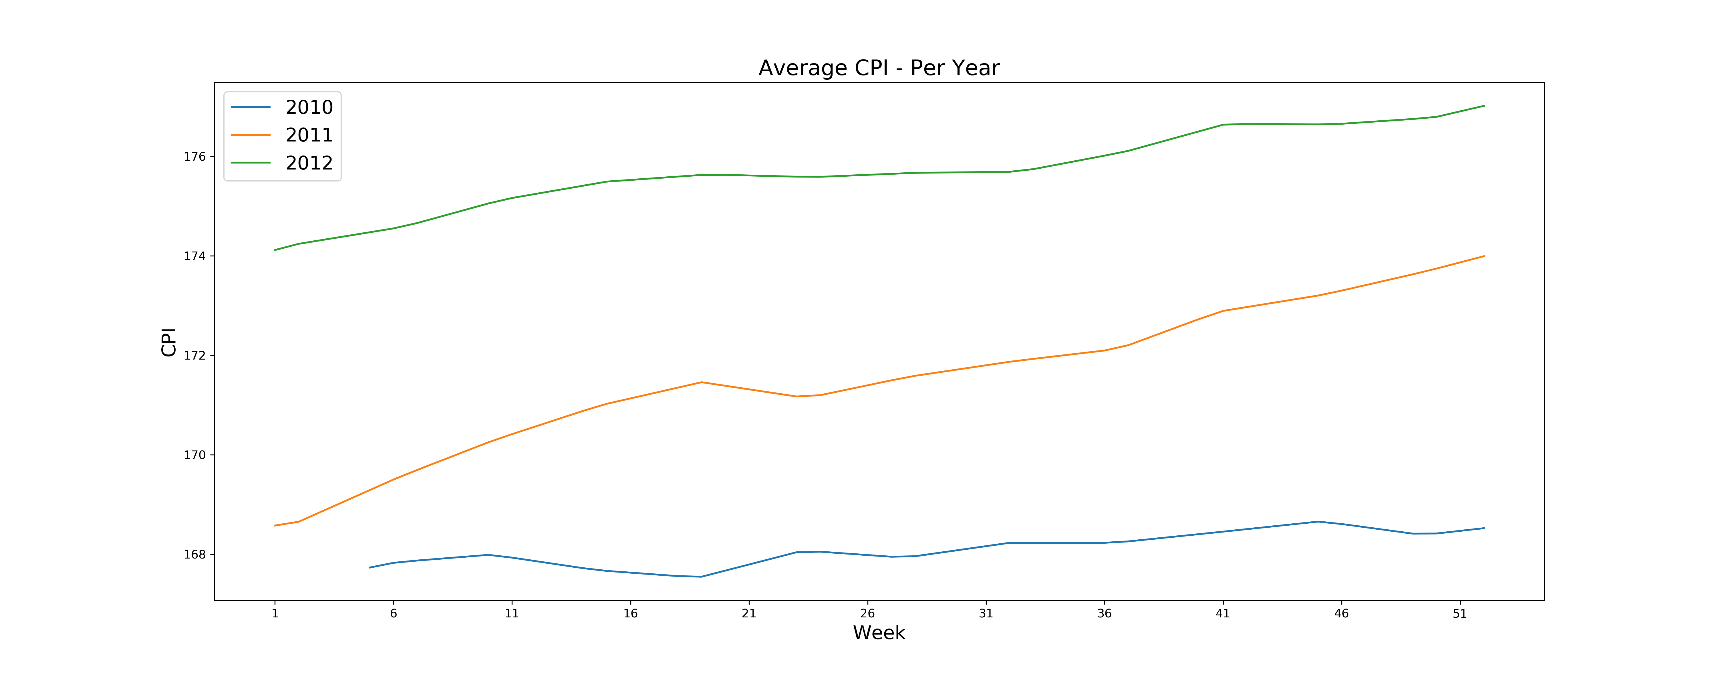
Results and findings (con’t)
Definition of CPI
The CPI measures the average change in prices over time that consumers pay for a basket of goods and services, commonly known as inflation
Generally, the dollar’s purchasing power declines when the aggregate price level increased and vice versa
Average CPI per year
2010: 167.73
2011: 171.18
2012: 175.07
CPI (or inflation rate) duration
2010-2011: 2.06
2011-2012: 2.27
Summary
Comparing the 3 years, the CPI (inflation) is increasing which results in lower interest rate and lower sales revenue.
Thus, CPI and interest rate / sales revenue are inversely proportional.
Notes:
Yen

Slide 12
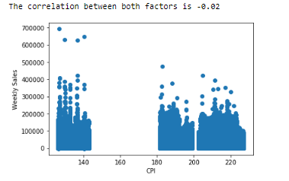
Results and findings (con’t)
Correlation:
There was no obvious correlation between CPI and average weekly sales revenue
The R-Value between CPI and weekly sales revenue was -0.02.
CPI and weekly sales revenue are inversely proportional.
The CPI value during 2010 is lowest as compared to 2011 and 2012. Therefore, sales revenue in 2010 is slightly higher than 2011 and 2012.
Notes:
Yen

Slide 13
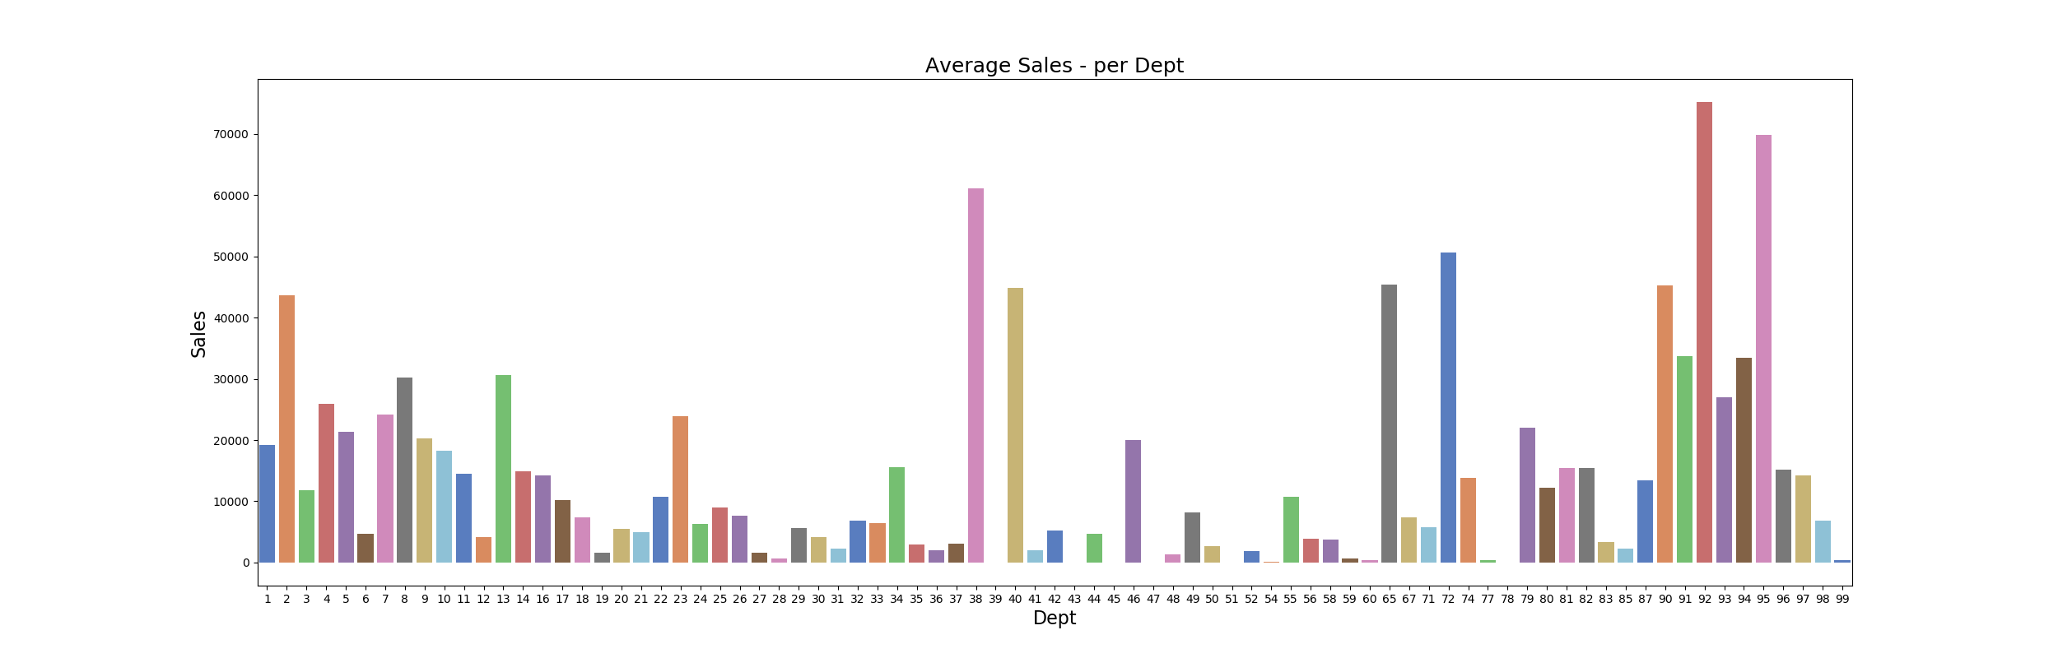
Results and findings (con’t)
The highest average sales departments: 92, 95 and 38
The lowest average sales departments: 43, 47, 51
We were not able to correlate the department #’s from the department names, as this data was not provided.
Notes:
Yen
The highest average sales departments: 92 (dry grocery), 95 (snacks and beverages) and 38 (prescription drugs)
The lowest average sales departments: 43 (toy models), 47, 51 (fishing equipment)

Slide 14
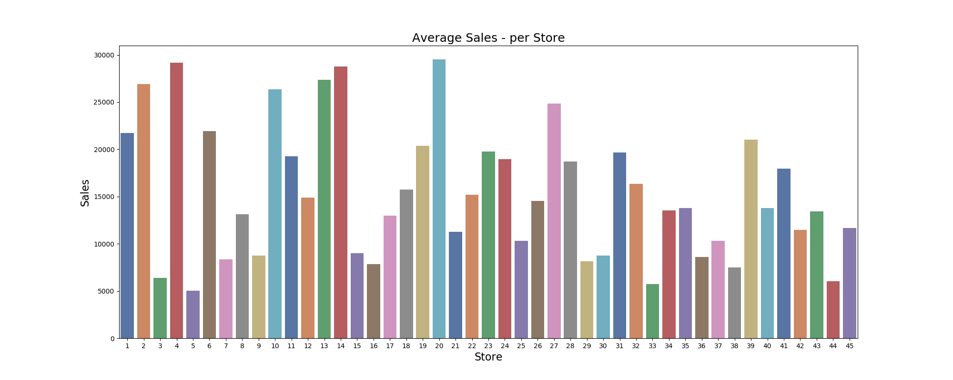
Results and findings (con’t)
Average Sales from Top 3 stores: 4, 14 and 20
Average Sales from Bottom 3 stores: 5, 33, 44
We were not able to correlate the store #’s from the store names, as this data was not provided.
Notes:
Tasneem

Slide 15
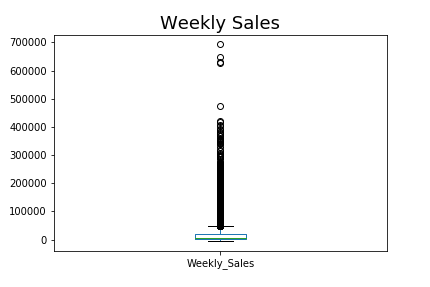
Results and findings (con’t)
This chart provides the maximum weekly sales per year.
It is determined that Black Friday/Cyber Monday is the maximum sales revenue generating Holiday throughout the year.
Notes:
Tasneem

Slide 16
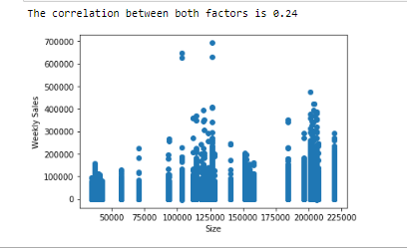
Results and findings (con’t)
Correlation
R-Value of weekly sales vs Walmart store size is 0.24.
This results in insufficient data to provide a strong correlation between store size and weekly sales.
Notes:
Tasneem

Slide 17

LIMITATIONS
Sufficient data was not provided to determine strong correlation between sales revenue and the data features
Data was not given on the typical products that were sold in order to determine consumer “hot” products.
”Markdown” data was not well-defined nor provided in order to visualize and support our conclusions.
Walmart store sampling and the data collection methodologies were not at all defined.
Notes:
Adil

Slide 18
CONCLUSION SUMMARY
Determine highest (max) sales revenue based on the US holidays
Highest sales revenue occurred during Thanksgiving weekend (Black Friday/Cyber Monday), Week 47.
Study the average sales per week for all stores and departments throughout the years 2010-2013.
Highest average sales per week occurred during Christmas, Week 51. The second highest average occurred during Thanksgiving weekend.
Does holiday have any impact in the # of sales revenue?
Yes, holiday does have a big impact in sales revenue.
Contributing factors/correlation to sales revenue, such as:
Temperature, CPI, Unemployment, Fuel Price, Holiday, Store Size
There was no correlation in Temperature, Fuel Price
However, we did see slight correlation between CPI, unemployment and store size to the sales revenue.
We were not able to visualize any significant (strong) correlation between sales revenue and the aforementioned data factors.
Notes:
Adil

Slide 19

QUESTIONS?
Notes:
NexGen

